Slide 1
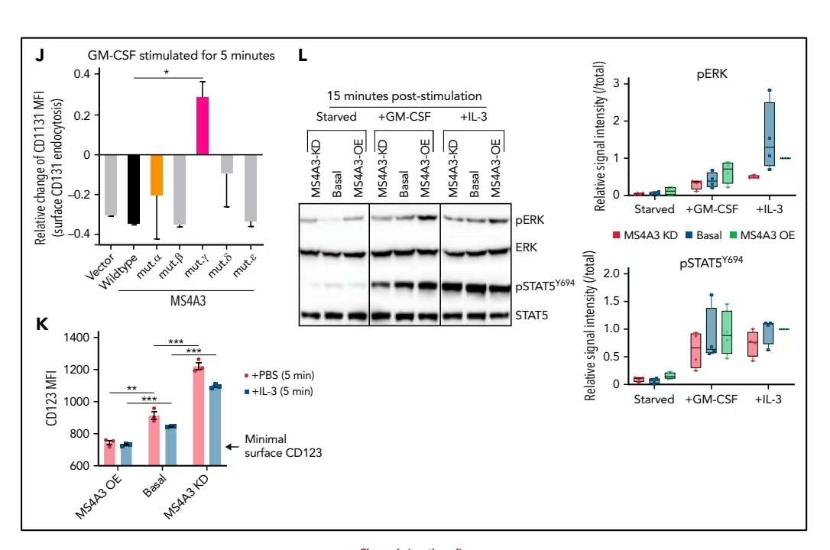
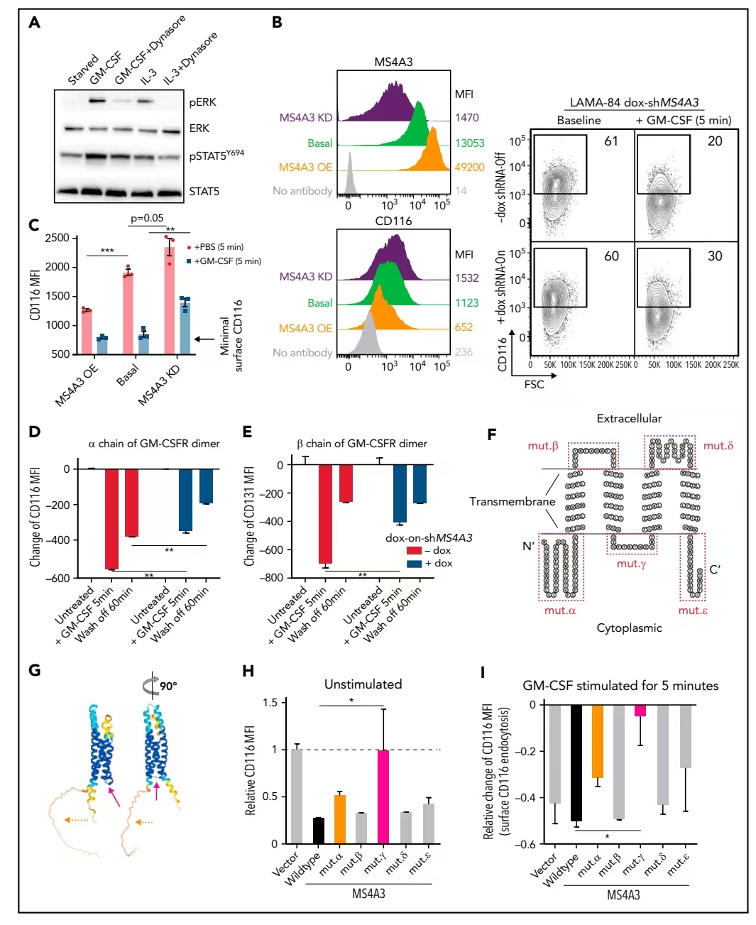
Zhao H, Pomicter AD, Eiring AM, Franzini A, Ahmann J, Hwang JY, Senina A, Helton B, Iyer S, Yan D, Khorashad JS, Zabriskie MS, Agarwal A, Redwine HM, Bowler AD, Clair PM, McWeeney SK, Druker BJ, Tyner JW, Stirewalt DL, Oehler VG, Varambally S, Berrett KC, Vahrenkamp JM, Gertz J, Varley KE, Radich JP, Deininger MW. MS4A3 promotes differentiation in chronic myeloid leukemia by enhancing common β-chain cytokine receptor endocytosis. Blood. 2022 Feb 3;139(5):761-778. doi: 10.1182/blood.2021011802. PMID: 34780648; PMCID: PMC8814676. 分享者姓名 仇维健
结论：MS4A3介导GM-CSF/IL-3受体内吞并增强下游ERK/STAT5信号

Slide 2
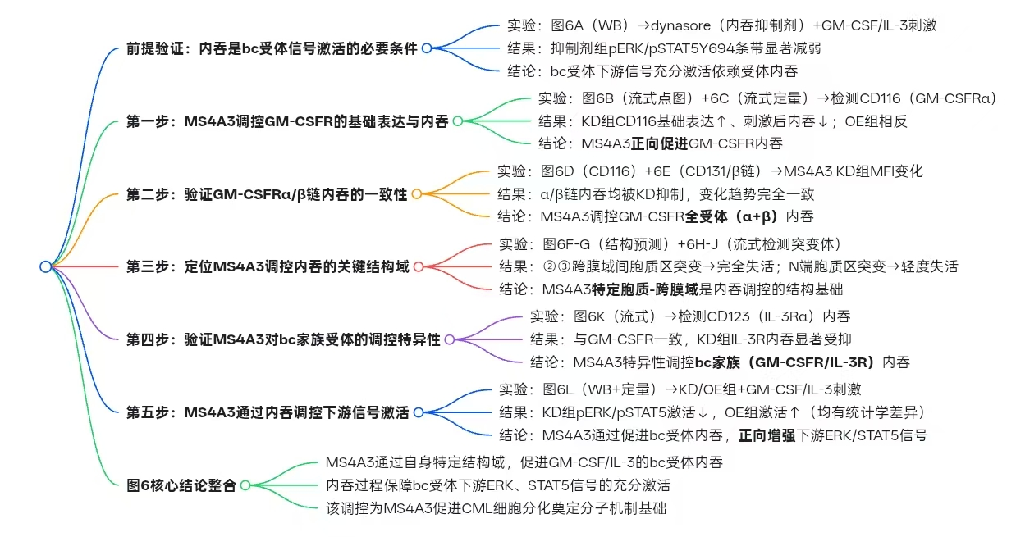

Slide 3
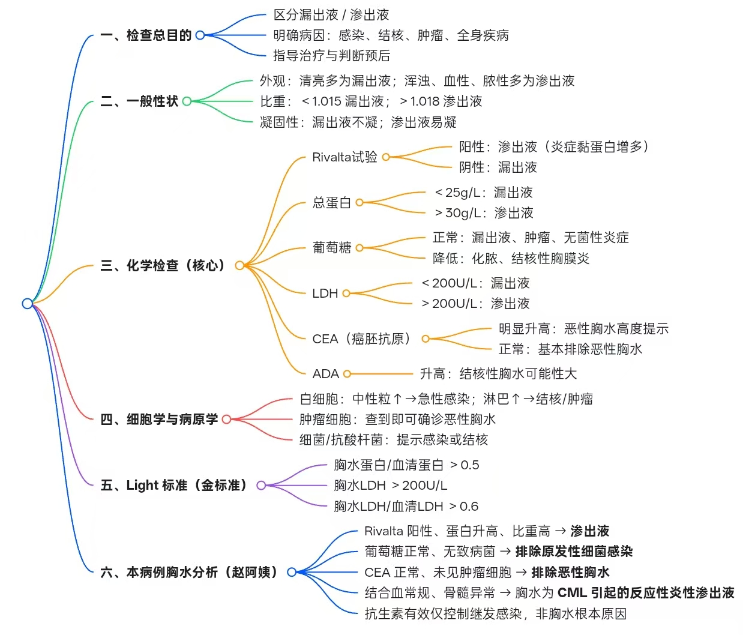
Q1：胸水穿刺常用的实验室检查指标及意义（Rivalta实验、CEA） 姓名 仇维健
万学红，卢雪峰，主编. 诊断学[M]. 10版. 北京: 人民卫生出版社, 2024：315-519，399.

